Slide 1
Using Microsoft Cognitive Services
“How to make
smarter apps…”
Justine Cocchi – Microsoft Technical Evangelist
@JustineCocchi

Slide 2

Agenda
Overview of Cognitive Services
Hands on Workshop

Slide 3


Cognitive Services
microsoft.com/cognitive
Vision
Speech
Language
Knowledge
Search
Computer Vision
Custom Recognition
Bing Spell Check
Academic Knowledge
Bing
Web Search
Emotion
Speaker Recognition
Linguistic Analysis
Entity Linking
Bing
Image Search
Face
Speech
Language Understanding
Knowledge Exploration
Bing
Video Search
Video
Translator
Text Analytics
QnA Maker
Bing
News Search
WebLM
Bing
Autosuggest
Notes:
Go to Microsoft.com/cognitive → show Emotion API Reference

Slide 4







Why Microsoft Cognitive Services ?
Easy
Flexible
Tested
Roll your own with REST APIs
Simple to add: just a few lines of code required
Make the same API code call on iOS, Android, and Windows
Integrate into the language and platform of your choice
Built by experts in their field from Microsoft Research, Bing, and Azure Machine Learning
Quality documentation, sample code, and community support
GET A KEY
BUILD

Slide 5


Slide 6

Powerful Models
Cognitive Services models are trained using the same deep learning and machine learning techniques that power many products across Microsoft

Slide 7

Vision APIs

Slide 8
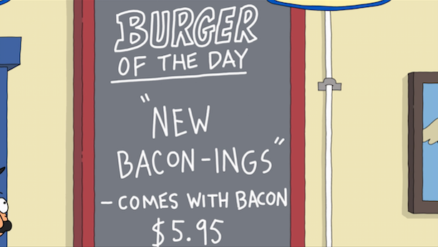
Computer Vision - OCR
TEXT:
OF THE DAY
NEW
BACON -INGS
- COMES WITH BACON
JSON:
{
"language": "en",
"textAngle": -1.8000000000000336,
"orientation": "Up",
"regions": [
{
"boundingBox": "137,68,261,274",
"lines": [
{
"boundingBox": "167,68,183,35",
"words": [
{
"boundingBox": "167,75,41,28",
"text": "OF"
},
{
"boundingBox": "223,72,56,25",
"text": "THE"
},
{
"boundingBox": "294,68,56,29",
"text": “DAY"
}
]
};
. . .

Slide 9
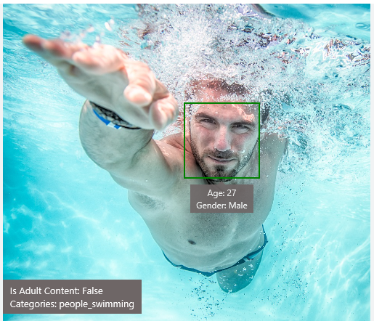
Computer Vision - Analyze Image
Type of Image:
Clip Art Type 0 Non-clipart
Line Drawing Type 0 Non-Line Drawing
Black & White Image False
Content of Image:
Categories [{ “name”: “people_swimming”, “score”: 0.099609375 }]
Adult Content False
Adult Score 0.18533889949321747
Faces [{ “age”: 27, “gender”: “Male”, “faceRectangle”: {“left”: 472, “top”: 258, “width”: 199, “height”: 199}}]
Image Colors:
Dominant Color Background White
Dominant Color Foreground Grey
Dominant Colors White
Accent Color

Slide 10

Face APIs

Slide 11
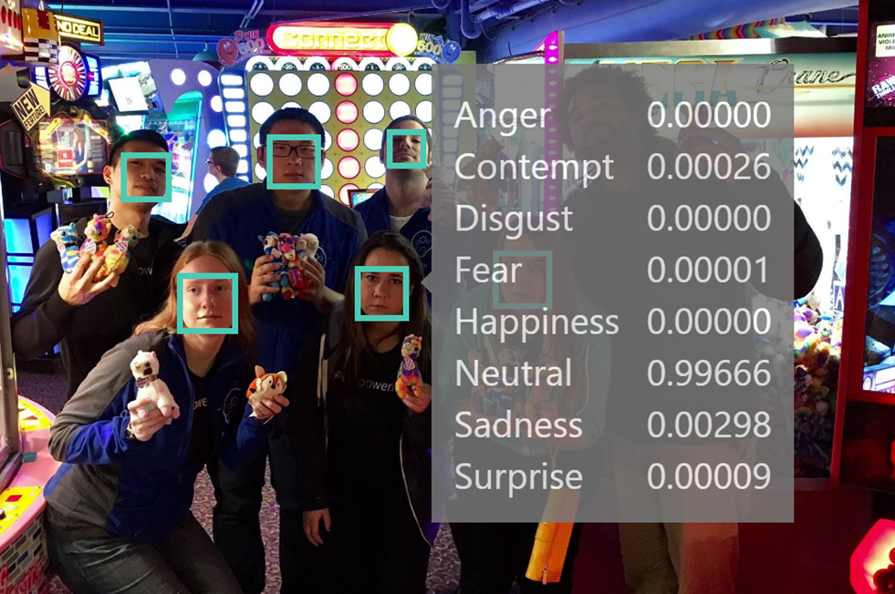
Emotion Recognition
Detection Result:
6 faces detected
JSON:
[
{
"faceRectangle": {
"left": 859,
"top": 790,
"width": 113,
"height": 113
},
"scores": {
"anger": 0.000004934181,
"contempt": 0.000258068641,
"disgust": 4.77232845e-7,
"fear": 0.000005691494,
"happiness": 0.00000247224739,
"neutral": 0.9966604,
"sadness": 0.00297707459,
"surprise": 0.000090872
}
},
. . .

Slide 12

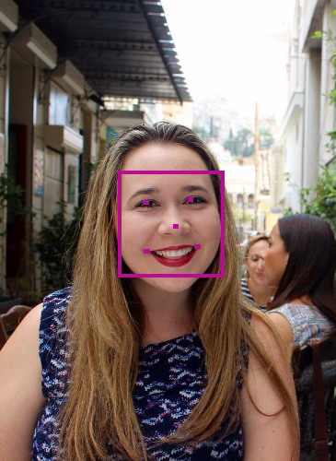

Face Analytics
[
{
"faceId": "5a89cea3-1451-42ff-a875”
"faceRectangle": {
"width": 269,
" height": 269,
"left": 303,
"top": 434
},
"faceLandmarks": {
"pupilLeft": {
"x": 374.1,
"y": 514.6
},
"pupilRight": {
"x": 486,
"y": 506.1
},
. . .
“faceAttributes": {
"age": 31.2,
"gender": "female",
"headPose": {
"roll": -6.2,
"yaw": 8.6,
"pitch": 0
},
"smile": 0.238,
. . .
Notes:
https://www.mymoustache.net

Slide 13
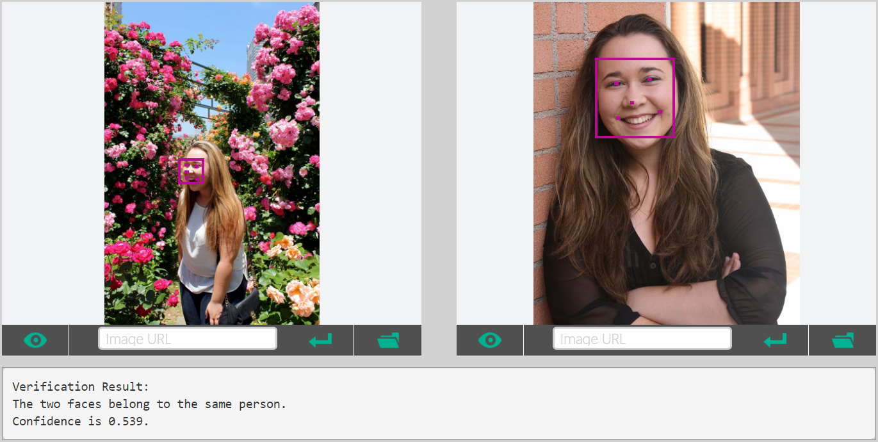
Facial Verification
.
.
.
.
.
.
.

Slide 14

Speech and Text APIs

Slide 15

Voice Recognition
es-ES
de-DE
fr-FR
en-GB
it-IT
en-US
zh-CN
Converts spoken audio to text
Same backend which powers Cortana
Support for 7 languages at launch

Slide 16
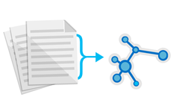



Text Analytics
de-DE
es-ES
fr-FR
en-GB
it-IT
en-US
zh-CN
Sentiment analysis
Key phrase extraction
Language detection for 120 languages
Notes:
Whatnottowatch.azurewebsites.net

Slide 17

LUIS Language Understanding Intelligent Service

Slide 18
Language Understanding Intelligent Service
Lets you understand what your users are saying
Seamless integration with Speech Recognition
A few examples are enough to deploy an application
LUIS learns over time
Define
Concepts
Provide
Examples
Deploy
Active Learning

Slide 19
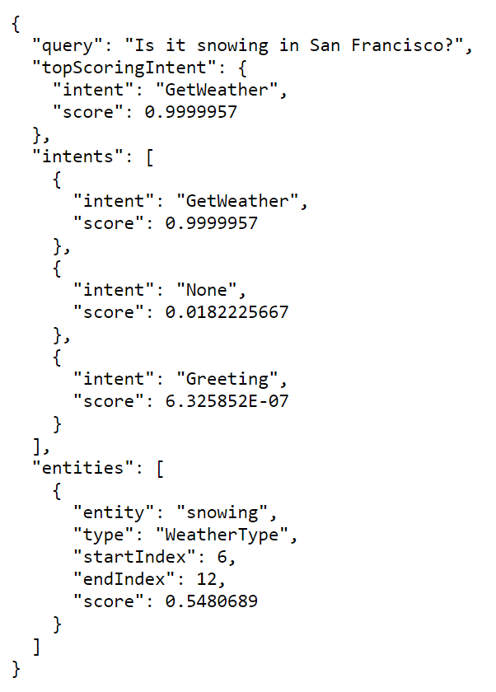
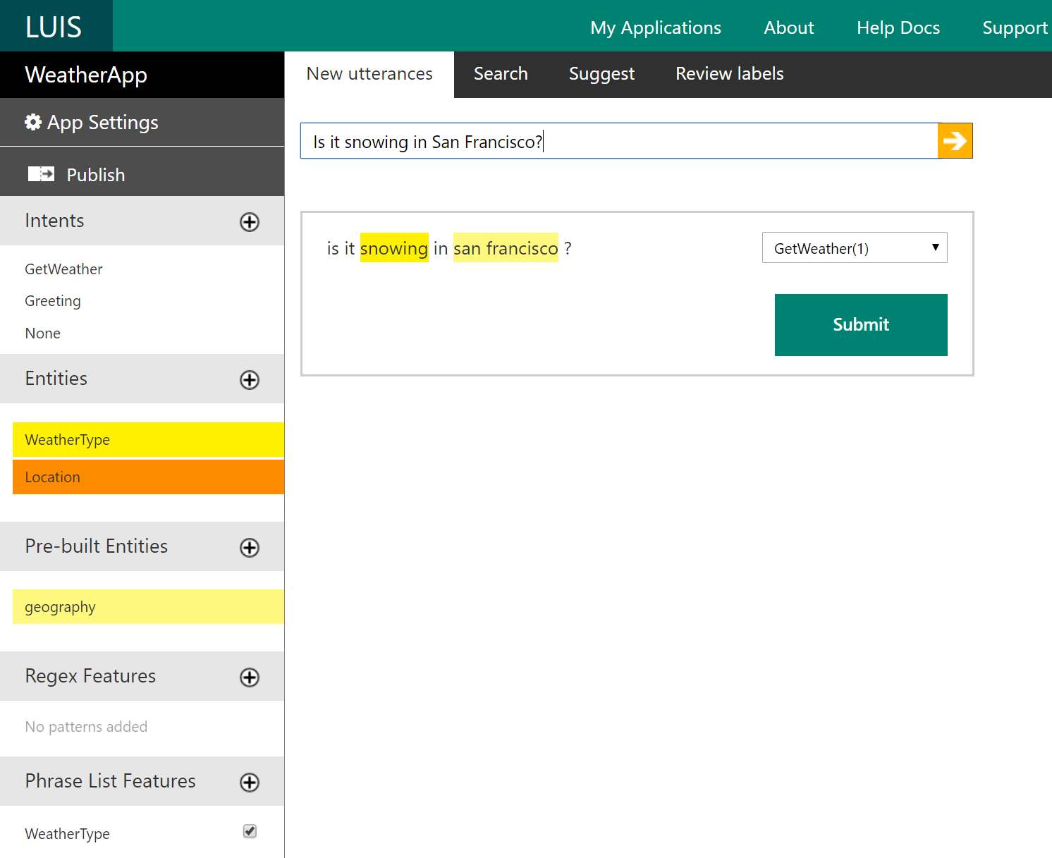
Notes:
Luis.ai

Slide 20
The Adventures of LUIS and CRIS
Hi, I'm CRIS
Hi, I'm LUIS

Slide 21

Custom Recognition Intelligent Service
Lets you overcome speech recognition barriers like speaking style, background noise, and vocabulary.
Custom language models
Custom acoustic models
Access Endpoint
Any Device

Slide 22
Microsoft Cognitive Services
A portfolio of REST APIs and SDKs which enable developers to write applications which understand the content within the rapidly growing set of multimedia data

Slide 23

Microsoft Cognitive Services
Combine APIs to Make Even Smarter Apps
Notes:
Murphy bot demo on skype

Slide 24
Workshop
microsoft.com/cognitive
Start coding
Lets see it in action!

Slide 25





What is .NET
Core?

Slide 26
Install the Prereqs
Install .NET Core at dot.net
There are extra steps for installing on Mac
microsoft.com/net/core#macos
Install a text editor like Visual Studio Code (works on PC, Mac, or Linux)
code.visualstudio.com

Slide 27
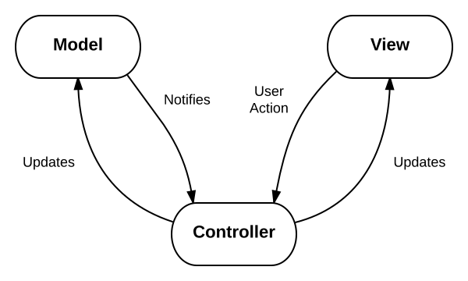
Lets take a look at the code
This design pattern is called MVC and is very popular for web applications
Model: The data for your application
View: The physical pages and layout of your application
Controller: The business logic of your application

Slide 28
Download or clone the repo
Aka.ms/CogServDemo
‘dotnet restore’
‘dotnet run’
Navigate to http://localhost:5000 in your browser
FYI- it’s not supposed to do anything yet!

Slide 29
Get Emotion Recognition API Key
Microsoft.com/cognitive
“Get Started for Free” and sign in with social auth
You must verify your account before subscribing to a trial
Subscribe to new Free Trials
Check Emotion – Preview and agree to the terms
Copy “Key 1” and save it for later

Slide 30
Make the API Call
Copy the content of CodeSnippets/MakeRequest.txt to the Controllers/HomeController.cs file
Technically this function can go anywhere in the file, but I recommend you put it in the “Helper Functions” section marked by the comments on line 58.
Enter your subscription key in place of
Uncomment the call to MakeRequest() on line 29
Verification
Set a breakpoint on the function call and run the project
If you look at the value of the ‘results’ variable we just uncommented, you should now see the JSON returned by Cognitive Services as a string!
Our site hasn’t changed yet, it will simply reload the home page again like before

Slide 31
Parse the Result to find the Top Emotion
Copy the content of CodeSnippets/TopEmotion.txt to the Models/EmotionSet.cs file, inside of the Scores class
This new function replaces the empty Max() function already in the Scores class
Copy the content of CodeSnippets/ParseResults.txt to the Controllers/HomeController.cs file
I recommend you put it in the “Helper Functions” section below MakeRequest()
Uncomment the call to ParseResults() on line 32
Verification
Set a breakpoint on the function call and run the project
If you look at the value of the ‘topEmotion’ variable, you should see the top emotion
Site functionality still hasn’t changed yet

Slide 32
Make the Suggestion and Display Results
Copy the content of CodeSnippets/MakeSuggestion.txt to the Controllers/HomeController.cs file
I recommend you put it in the “Helper Functions” section below MakeRequest()
Uncomment the call to MakeSuggestion() on line 35
Delete the temporary ‘return View()’ on line 41 and uncomment ‘return RedirectToAction()’ on line 38
This is how we will display the results on our site
Verification
Now when we enter a link to a photo and press submit, the site should redirect to a results page, displaying an image based on the top emotion found in the photo!

Slide 33
Customize your Site
Change the theme by editing the images and descriptions for each emotion in MakeSuggestion()
In .NET Core, all static files are stored in the wwwroot/images folder so be sure to put your images here in order for them to be displayed
Change the way you use the API
We have it set up to take the top emotion and do something based on that result, maybe you want to customize based on the combination of the top two emotions or maybe you only care about the score for one particular emotion and want to customize your site based on that.
Get creative!
Add additional API calls, mix and match the Cognitive Services to make even more compelling applications

Slide 34
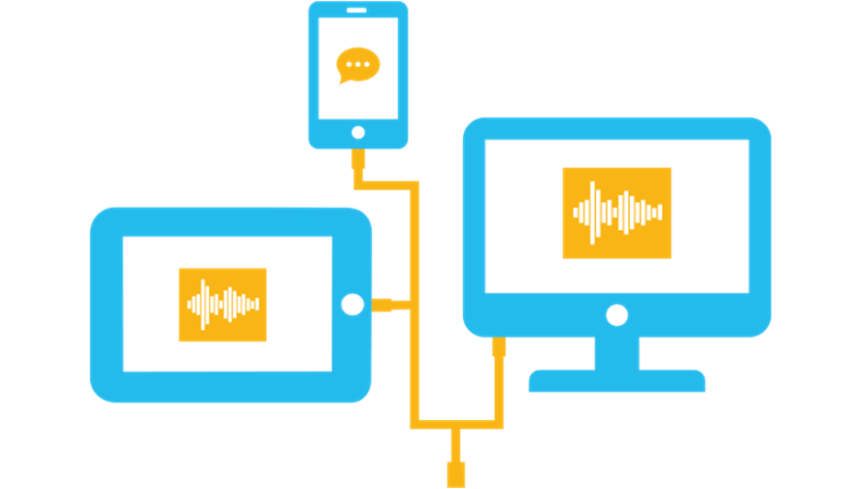
Add Cognitive Services APIs to Your Own Apps
Get subscription key
Make API call
Parse JSON response
Do something with the results

Slide 35

Azure Functions, Cognitive Services, and IoT
Tuesday, Feb 28th from 15:30 to 21:00 @ CTRL Collective
RSVP: aka.ms/MarsMissionLA

Slide 36
Justine.Cocchi@Microsoft.com
@JustineCocchi

